Slide 1

UNIVERSITY OF PETROLEUM & ENERGY STUDIES
School of Computer Science
Dehradun
COURSE: IT Security
July – December 2023
Delivered by
Dr. Gopal Singh Rawat
1

Slide 2
Course Plan
Introduction to IT System Security
Operating System Security
Endpoint Security
Application Server Security
Database Server Security
IT System Security Processes

Slide 3
Unit #3: Endpoint Security

Slide 4
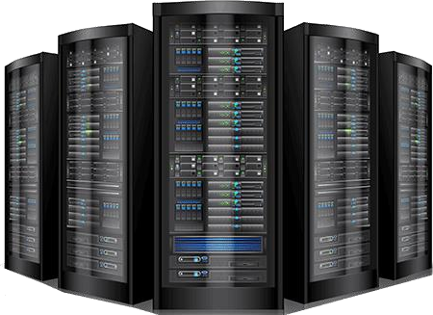
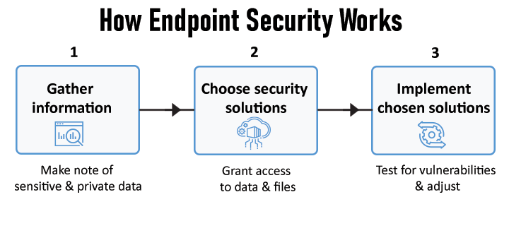
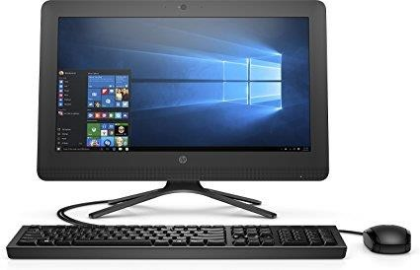
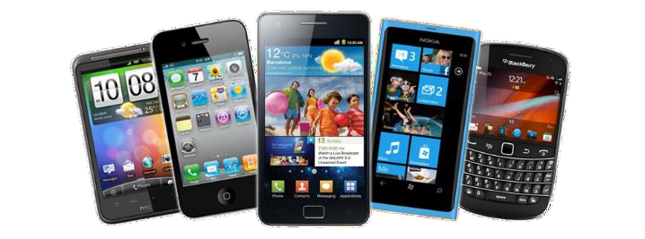
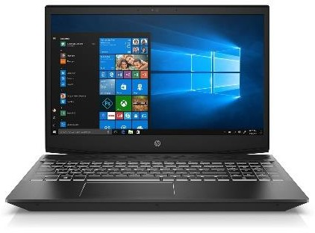
3.1 Endpoint Security
What is an Endpoint
User and System devices offering ways to connect to a network (Office, University) via LAN and Wifi
Removable devices → USB Flash drives, Wireless cards, Memory cards, Card Reader
Older → CD, DVD, PDA, MP3 Players, External Storage, Zip Drives, Biometrics
Transfer data to/from Endpoint devices
Hand held Smart Mobiles
Laptops
Desktops (home/office PCs)
Hosted Server systems

Slide 5
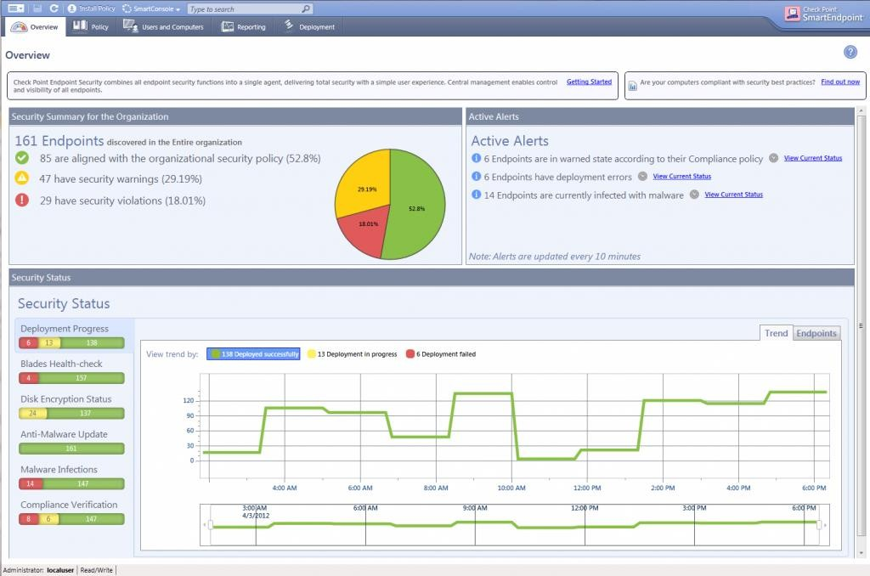
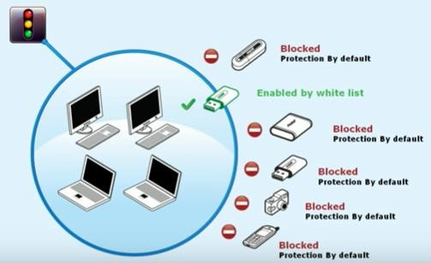
3.2 Aim of Endpoint Security
Prevent data from being hacked, stolen, copied, transferred (unauthorized / unsecure)
Systems being compromised → Virus, Malware, Spyware infections via removable devices
“At least 80% of Data Loss occurs due to Company Insiders (not External Hackers)” – 2018 Gartner Research
3.2 Components of Endpoint Security
End Point Agent
EP Logs
Policy
End Point Console
(Management and Monitoring over Cloud)
End Point Systems
Notes:
An endpoint agent is a lightweight background app installed on a device’s operating system to constantly assess it for vulnerabilities

Slide 6
3.3 Endpoint Security Functionality
Data loss prevention
Insider threat protection
Disk, endpoint, and email encryption
Application whitelisting or control
Network access control
Data classification
Endpoint detection and response
Privileged user control
3.4 How is Endpoint Security different from Anti Virus
Installed in Home or Small environments Signature based program → receives updates from the vendor’s control severs via Internet Threat Alerts or Logs → viewed on individual machines, not a centralized console Can be stopped/modified on individual system locally Passive Security – update and scan on desktop | Centrally managed interface for configuring endpoints Access every log entry and alerts of various endpoints from one location for entire organization Automatic downloading of Agent or App updates when released by the central management system Policies and standardization of network usage and access Enforcement of Network-wide standard policies, Encryption, USB Proactive Security – internal and external security threats
Notes:
Consumer vs Corporate

Slide 7
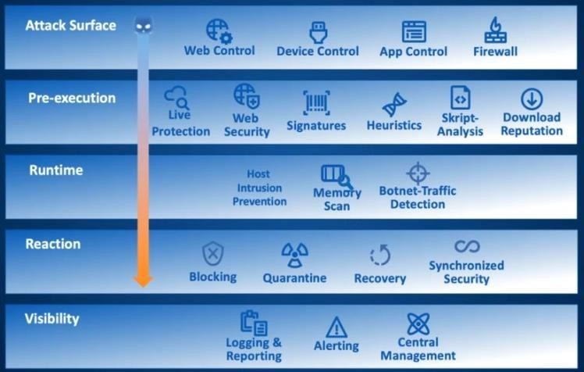
3.3 Endpoint Security Functionality

Slide 8
Four Pillars of Endpoint Security
Endpoint hardening – protect the endpoint from attack
Antivirus, Antimalware software
Maintain integrity levels
Auditing of network resource access
Endpoint resiliency – make the endpoint auto-healing
Monitoring, Patching , Network Access Protection
Network prioritization – guard network bandwidth
DiffServ and QoS
Network resiliency – make the network auto healing
Clustering, replication and virtualization
Notes:
Differentiated services (DiffServ or DS) is a class of service (CoS)

Slide 9
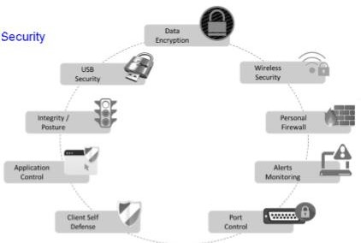

3.5 Security Areas (Aspects) covered by an Endpoint Security Solution:
Personal Firewall
Wireless Security
Port Control
Data Encryption
USB and Storage Device Security
Application Control → Whitelist
Integrity and Remediation
Client Self-Defense
Alerts Monitoring

Slide 10
3.6 Examples of Endpoint Security and Antivirus
Endpoint Security:
Antivirus:
1.CrowdStrike 2.Trend Micro 3.Carbon Black 4.Comodo
Malwarebytes
AVG
Sophos Home 4.Avira
3.7 Business Need for Endpoint Security (Drivers that influence the Endpoint Security)
Correct and reliable operation
Service Level Agreements (SLA), Contractual Obligation
IT Asset Value
Protect Business Asset Value / Brand Image
Legal and Regulatory Compliance
Financial loss and Liability
Critical Infrastructure Protection
Safety and Survival in dynamic world

Slide 11
3.8 IT Drivers that influence the Endpoint Security:
Internal Threats and Threat Agents
External Threats and Threat Agents
IT Service Management Commitments – SLAs
IT Environment Complexity – multiple small locations, remote access, working from home, temp offices, airports, hotels
Business Environment Complexity
Audit and Traceability
IT Vulnerabilities – Configuration, Flaws, Exploits
End User Complexity
Fast Growing Web Threats
VPN Security Challenges
3.9 Major challenges while delivering Endpoint Security:
Protecting Mobile Users
Client-side Performance
IT Staff Training / Capability
Cloud & Internet dependency

Slide 12
3.10 Gartner’s Magic Quadrant
Gartner is the world's leading research and advisory company.
Equip business leaders with insights, advice and tools to achieve their business goals by releasing yearly reports.
Gartner evaluates → Strengths and Weaknesses of Endpoint Protection Platform Vendors
These vendors are considered the most significant in the market based on distinct service and market share criteria.
The report then provides readers with a graph → Magic Quadrant
This graph plots the vendors based on the features, capability and completeness of ability to execute and vendor strengths and weakness.
The four categories of the Quadrant are labeled Leaders, Visionaries, Challengers, or Niche Players.
Gartner readjusts its evaluation criteria, often in response to market changes, each year.
Therefore, sometimes vendors who appeared in the Magic Quadrant one year may not return for the next one.
Gartner defined an EPP as “Solution deployed on Endpoint devices to
Prevent file-based malware
Detect and block malicious activity from trusted and untrusted applications
Provide the investigation and remediation capabilities needed to dynamically respond to security incidents and alerts.”
Notes:
endpoint-protection-platform (epp)

Slide 13
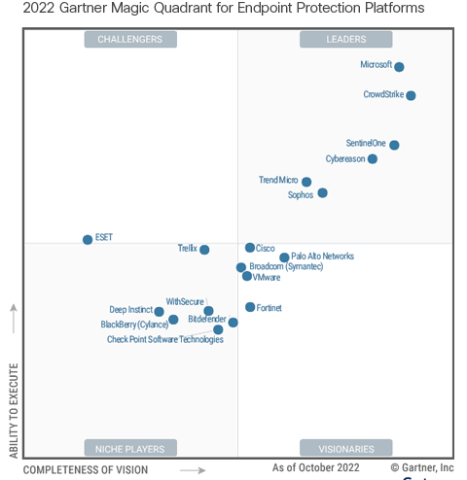
3.10 Gartner’s Magic Quadrant

Slide 14
3.11 Latest Endpoint Security Threats and Risks
Latest Security Vulnerabilities | Discovered
Microsoft Skype for Android CVE-2019-0622 Local Privilege Escalation Vulnerability | 8th Jan 2019
Microsoft Exchange Server CVE-2019-0588 Information Disclosure Vulnerability | 8th Jan 2019
Microsoft SharePoint Server CVE-2019-0562 Remote Privilege Escalation Vulnerability | 8th Jan 2019
Microsoft Exchange CVE-2019-0586 Remote Memory Corruption Vulnerability | 8th Jan 2019
Latest Security Risks | Type | Discovered
Miner.Softminer | Potentially Unwanted Program | 12th Dec 2018
Hacktool.ProcHack!g1 | Trojan | 3rd Jan 2019
Android.Clickads | Trojan Adware | 26th July 2018
Latest Security Threats | Type | Discovered
Linux.Ekcorminer | Trojan | 16th Jan 2019
SONAR.Tldr!g1 | Virus Worm | 15th Jan 2019
Bloodhound.RTF.13 | Trojan | 15th Jan 2019
Infostealer.Vidar | Spyware | 14th Jan 2019

Slide 15
Define Endpoint Security Vendor’s strength and weakness
Vendor | Strength | Weakness
Bit Defender | Strong hands-on & lab results Thorough support system Ransomware protection Included password manager Secure browser Inexpensive | PC only on inexpensive plans No firewall on base plan Limited number of devices No phone or live chat support No Linux protection
Checkpoint
Cylance
Eset
Fsecure
Heat Software
Kaspersky…..
Sophos
Cisco

